Slide 1
Separation of mixed cost

Slide 2
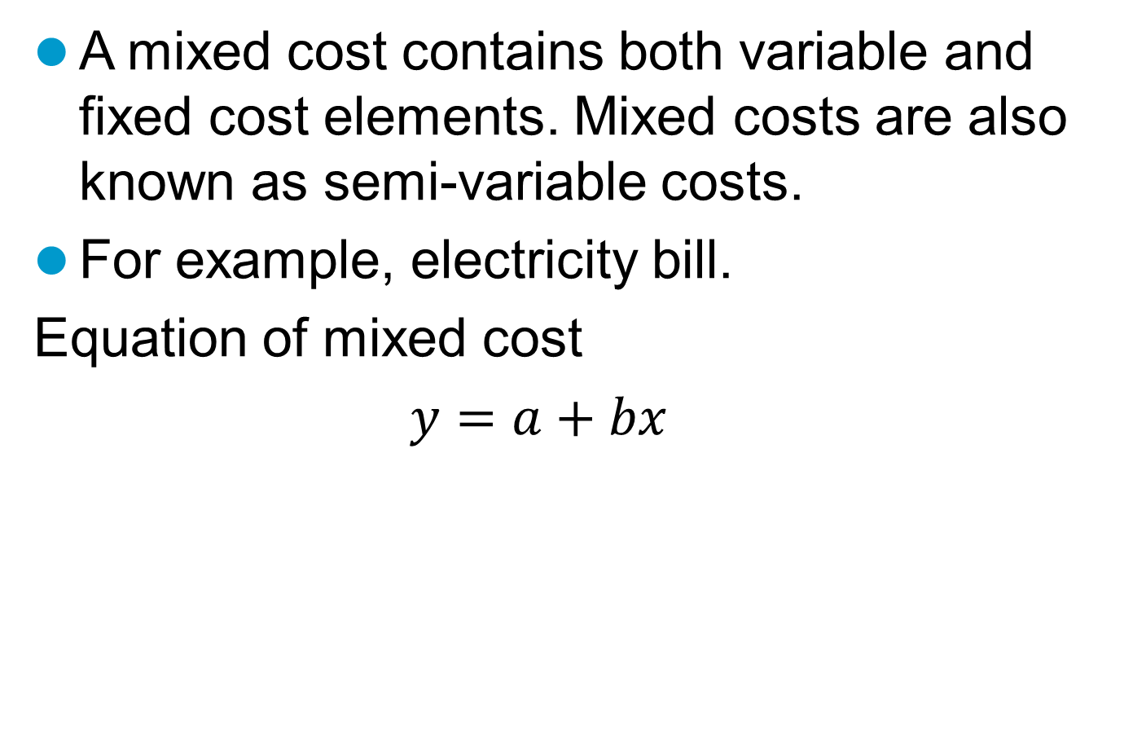
Mixed cost
A mixed cost contains both variable and fixed cost elements. Mixed costs are also known as semi-variable costs.
For example, electricity bill.
Equation of mixed cost
$y=a+bx$
Activity/production/no. of units
Total mixed cost
Variable cost per unit
Fixed cost

Slide 3
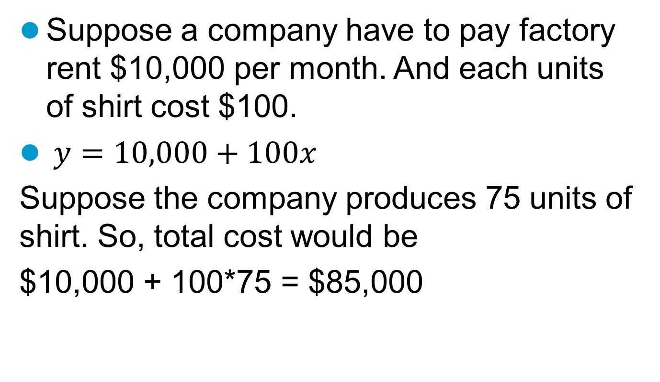
Mixed cost
Suppose a company have to pay factory rent $10,000 per month. And each units of shirt cost $100.
$y=10,000+100x$
Suppose the company produces 75 units of shirt. So, total cost would be
$10,000 + 100*75 = $85,000

Slide 4
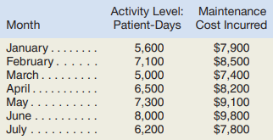
Method of separating mixed cost
See the following table which presents total cost of a business. The cost neither fixed nor variable.
We have to determine the amount of fixed component and variable component of the cost. There are two method to separate fixed and variable cost.
High-low method
Least square regression method

Slide 5
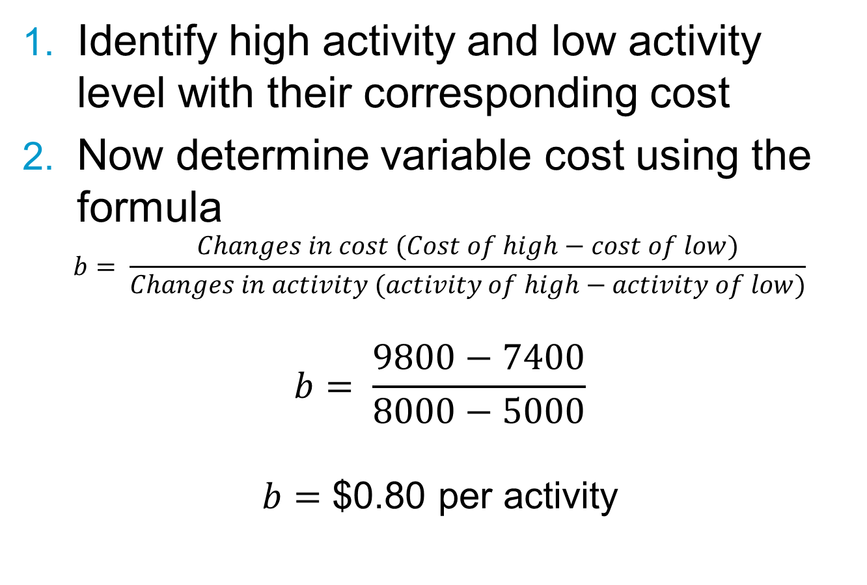
High-Low method
Identify high activity and low activity level with their corresponding cost
Now determine variable cost using the formula
$$b= \frac{Changes in cost (Cost of high−cost of low)}{Changes in activity (activity of high−activity of low)}$$
$$b= \frac{9800−7400}{8000−5000}$$
$b=$ $0.80 per activity

Slide 6
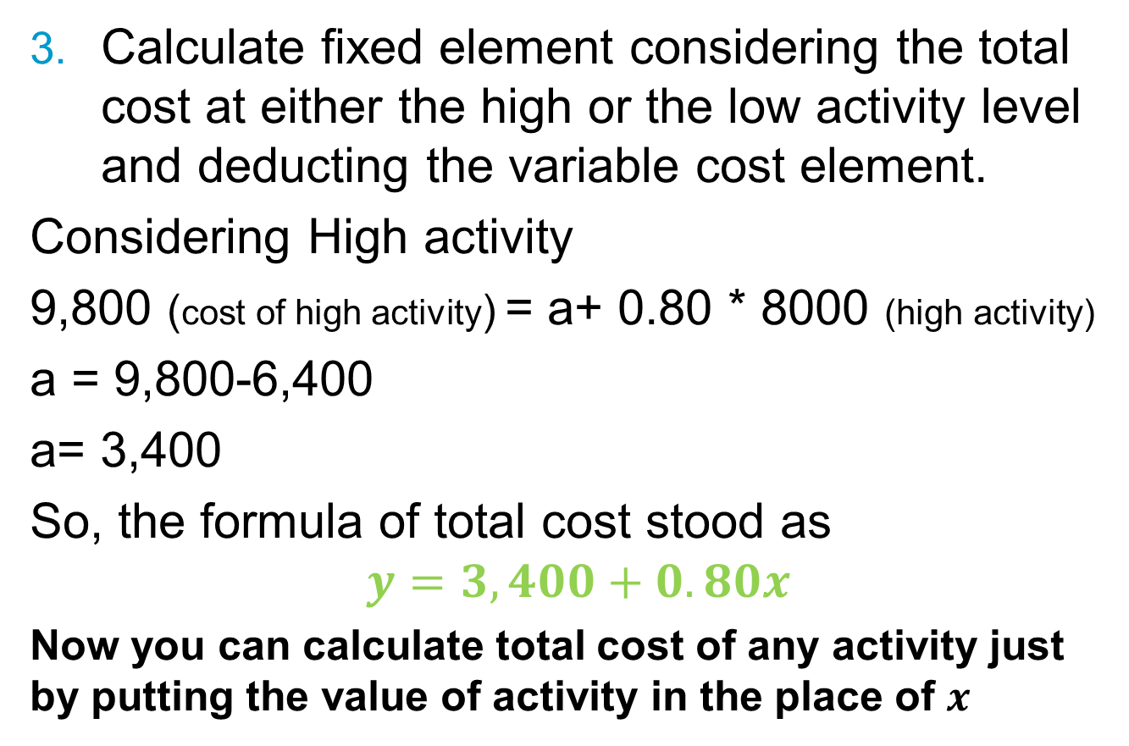
High-Low method
Calculate fixed element considering the total cost at either the high or the low activity level and deducting the variable cost element.
Considering High activity
9,800 (cost of high activity) = a+ 0.80 * 8000 (high activity)
a = 9,800-6,400
a= 3,400
So, the formula of total cost stood as
$$y=3,400+0.80x$$
Now you can calculate total cost of any activity just by putting the value of activity in the place of $x$

Slide 7

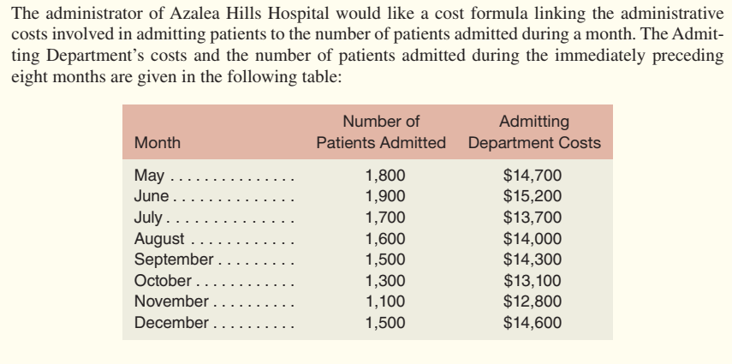
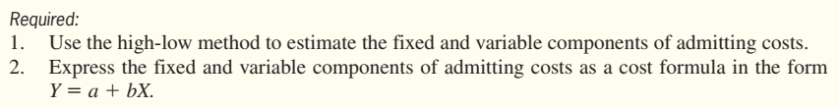

Slide 8
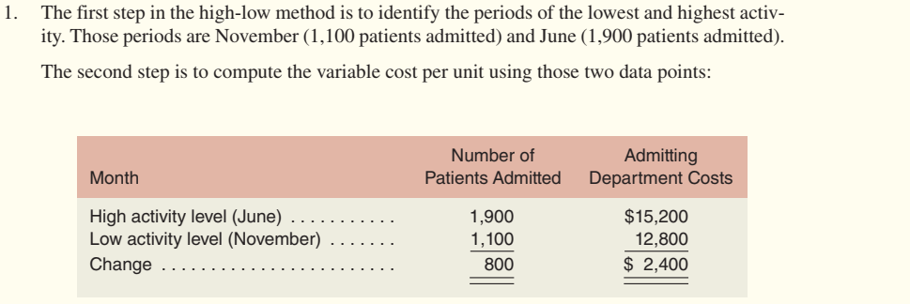
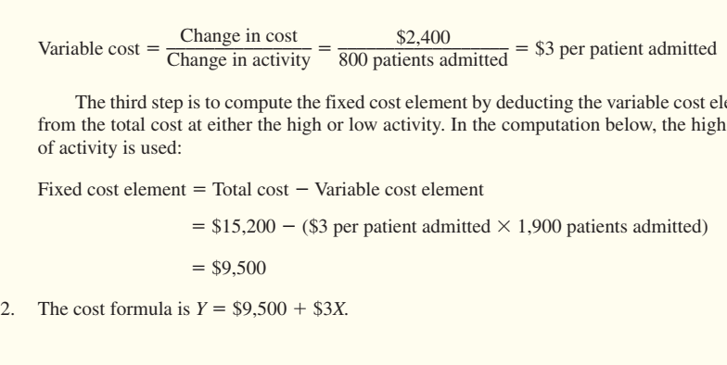

Slide 9
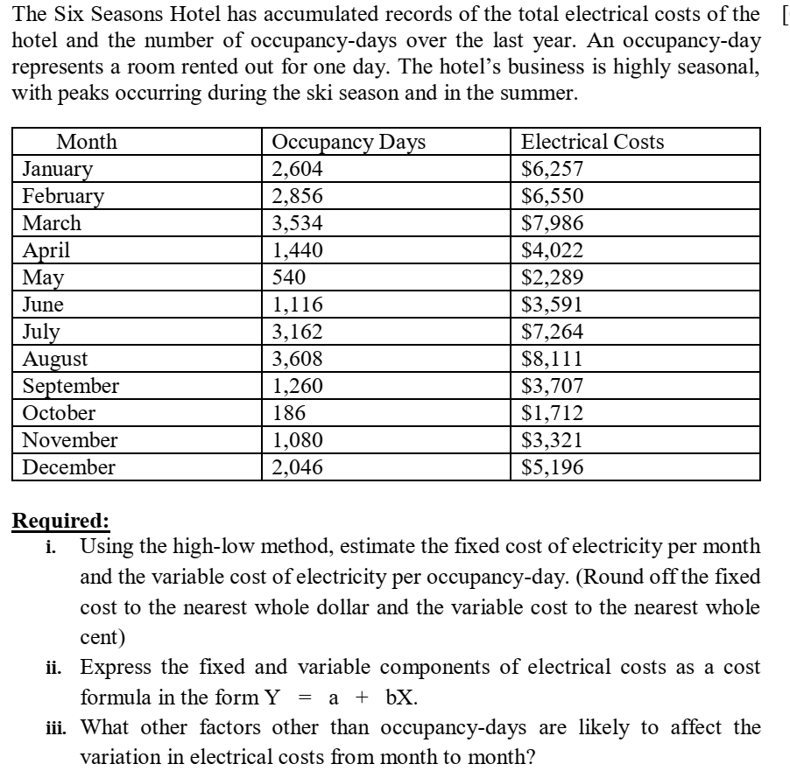

Slide 10
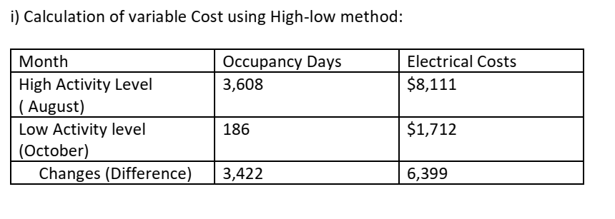
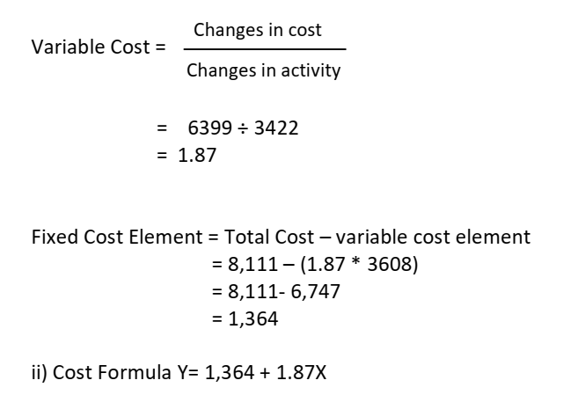

Slide 11
